Slide 1

LAB 2 SOFTWARE DESIGN AND ARCHITECTURE
NATIONAL UNIVERSITY OF MODERN LANGUAGES Faculty of Engineering and Computing Department of Software Engineering
Course Instructor: | Mr. Ahsan Arif
 | Lecturer Department of Software Engineering, NUML Islamabad

Slide 2
contents
How to start a new project?
What is a Use Case Diagram?
Use Case Diagram Example.

Slide 3


How to start a new project?
Imagine that you are working as a software engineer in the IT Company. Your company has done contract with organization to develop software for them.
Now how do you start the project as a software engineer?
Sure that you are not going to start from coding.
As a software engineer, you will follow the System Development Life Cycle.
First of all, we need the requirements of the system to start the project. The first step is to gather the requirement. During this phase of software development, you have to choose the best software development methodology so that you can work systematically and smoothly. Software development methodology will help you to execute, track the project and reduce the risk of project failure.
Assign New Project
Where to Start?

Slide 4
SYSTEM DESIGN
After Requirement Analysis, we move for designing the system before we start the coding.
Most of the students misunderstood regarding designing word. Designing in software engineering is
not talking about making wireframe or prototype designing
not about the interface design and color combination
Designing means:
Visualizing the internal system
Blueprint of the system
Deriving a solution
Traced customer’s requirements
Iterative process through which requirements are translated into a Blueprint for the software to be developed

Slide 5

We start the design with a high level of abstraction
In Object-Oriented view, we start designing from Use Case Diagram

Slide 6
Now, we have learn how to start drawing Use Case Diagrams and how to verify it…

Slide 7
Use Case Diagram
A Use Case is a description of a set of interactions between a user and the system.
Components of Use Case Diagram:
Actor
Use Case
System Boundary
Relationship

Slide 8
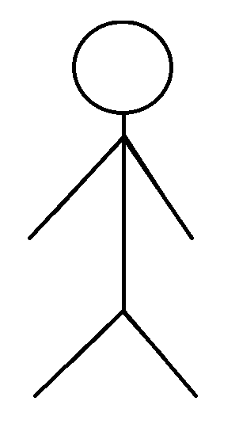
Use Case Diagram
Actor
An actor is someone or something that must interact with the system under development.
Usually represented by with a Stick Figure
An actor may be:
People
Computer hardware and devices
External System

Slide 9
Use Case Diagram
Use Case
A use case is a pattern of behavior, the system exhibits
The use cases are sequence of actions that the user takes on a system to get particular target
USE CASE is dialogue between an actor and the system
Represented by Oval Shape
Login

Slide 10
Use Case Diagram
System Boundary
It is shown as a rectangle
It helps to identify what is external versus internal, and what the responsibilities of the system are
The external environment is represented only by actors
Use Case Modeling Tool

Slide 11
Use Case Diagram
Relationship
Relationship is an association between use case and actor.
There are several Use Case relationships:
Association
Generalization
Include
Extend

Slide 12
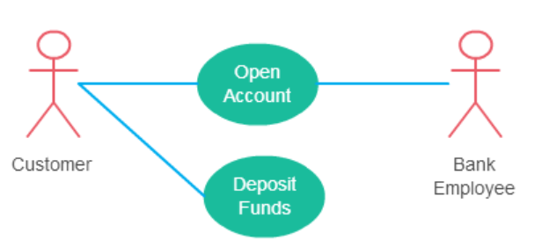
Use Case Diagram
Relationship – Association
An association is the communication path between and an actor and the use case that it participates in
It is shown as a solid line
It does not have an arrow, and is normally read from left to right
An actor must be associated with at least one use case.
An actor can be associated with multiple use cases.
Multiple actors can be associated with a single use case.

Slide 13
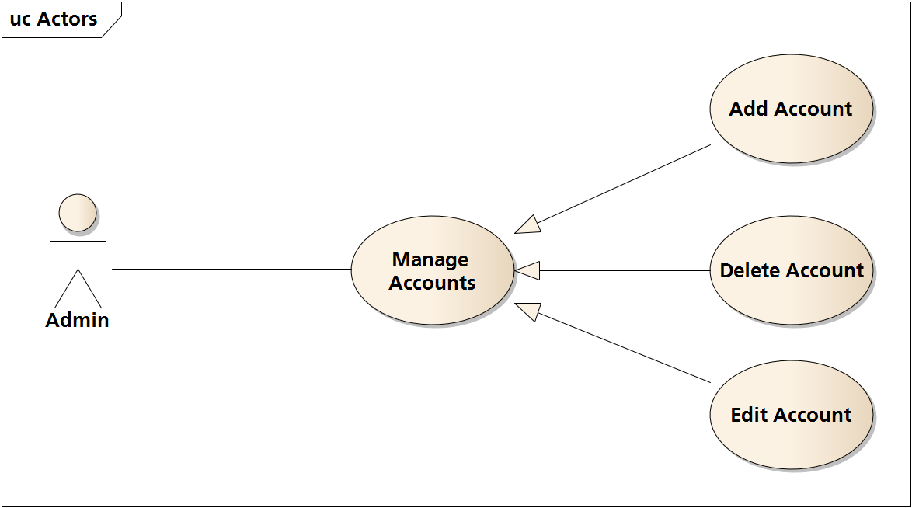
Use Case Diagram
Relationship – Generalization
Generalization is a relationship between a general use case and a more specific use case that inherits and extends features to it
It is shown as a solid line with a closed arrow point

Slide 14
Use Case Diagram
Relationship – Include
Include relationships insert additional behavior into a base use case
The “Include relationship” is shown by the dotted line with arrow and arrow must point to the included use case from the base use case and the keyword <<include>>
Include relationship show that the behavior of the included use case is part of the including (base) use case.
The main reason for this is to reuse common actions across multiple use cases. In some situations, this is done to simplify complex behaviors. Few things to consider when using the <<include>> relationship.
The base use case is incomplete without the included use case
The included use case is mandatory and not optional

Slide 15
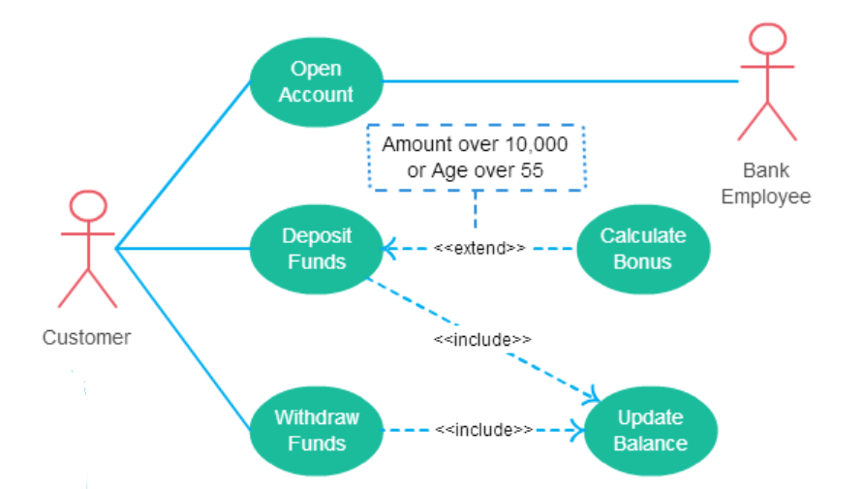
Use Case Diagram
Relationship – Include

Slide 16
Use Case Diagram
Relationship – Extend
As the name implies it extends the base use case and adds more functionality to the system
It is shown as a dotted line with an arrow point and labeled <<extend>>
Here are a few things to consider when using the <<extend>> relationship:
The extending use case is dependent on the extended (base) use case. In the below diagram the “Calculate Bonus” use case doesn’t make much sense without the “Deposit Funds” use case.
The extending use case is usually optional and can be triggered conditionally. In the diagram, you can see that the extending use case is triggered only for deposits over 10,000 or when the age is over 55.
The extended (base) use case must be meaningful on its own. This means it should be independent and must not rely on the behavior of the extending use case.

Slide 17
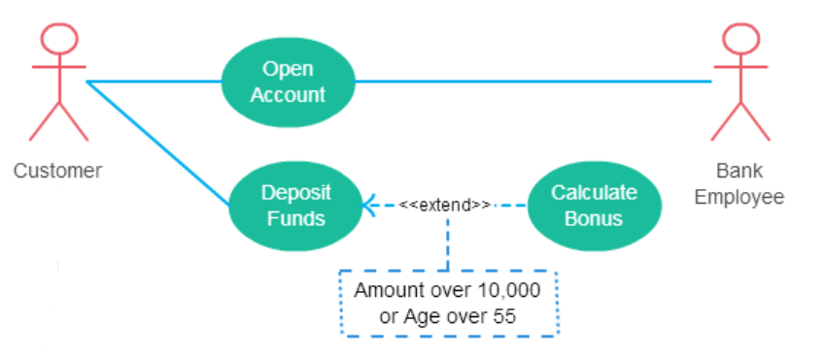
Use Case Diagram
Relationship – Extend

Slide 18
Check if there are any non-functional requirement use cases.
Check all the use case name properly whether it’s a active verb and a noun phrase or not.
Check the use cases are in logical order or not.
Check if there is any overlap and can be fix by reposition the use cases or actor.
Check whether use case diagram contain at least one include relationship or not.
Check whether there is line between the actors and the Included Use Case.
Check Whether include relationship arrow pointed to Included Use Case or not and is arrow label with include or not.
Check whether use case diagram contain at least one extend relationship or not.
Check whether there is line between the actors and the Extended Use Case.
Check Whether include relationship arrow pointed to Base Use Case or not and is arrow label with extend or not.
Check Whether the use case diagram contains any generalization or not.
Check Whether the arrow is solid line with an arrow pointing towards parent’s actors or not.
Make sure to represent all actors with a human stick image and contains more than one actors.
Make sure there is only one rectangle box representing as a system where all the use cases are included inside the box and actors are outside of the box.
Check whether you have written the system name inside the box at top or not.

Slide 19

Use Case Diagram – Checklist
In use case diagram, only mention the Functional requirement of the system. Functional Requirements like
Check if there are any Non-Functional Requirement in the use cases or not
Check Balance
Transfer Fund
Make payment
Non-Functional Requirements
Speed of execution, memory consumption, user friendliness, etc.

Slide 20
Use Case Diagram – Checklist
Use Case is denoted by the oval shape
Check Balance
Transfer Fund
Make payment
Check Balance
Check Balance

Slide 21
Use Case Diagram – Checklist
Use Case is denoted by the oval shape
Check Balance
Transfer Fund
Make payment
USE CASE | ACTOR
Check Balance | User, Staff
Transfer Fund | User
Make Payment | User
Display Error Message
Verify Log In Details
An active verb
and
A noun phrase
Check all the use case name properly whether it’s a active verb and a noun phrase or not. Also make sure the name of the use cases are meaningful.

Slide 22
Use Case Diagram – Checklist
All Use Cases should be inside the system
System Name
Login
Register
Book Service
Make Payment

Slide 23
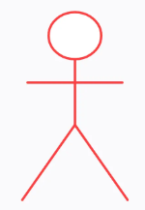
Use Case Diagram – Checklist
Put the Use Cases in a logical order
System Name
Login
Book Service
Make Payment
Customer
GOOD Practice Logical Order
IF POSSIBLE…
Easy to Understand the flow of a system

Slide 24
Thank You...
Mr. Ahsan Arif
Lecturer (Dept. of Software Engineering)
ahsanarif.se42@gmail.com

